Slide 1


Building a Pitch Deck
Guidance for crafting a clear, concise, and compelling presentation for investors

Slide 2
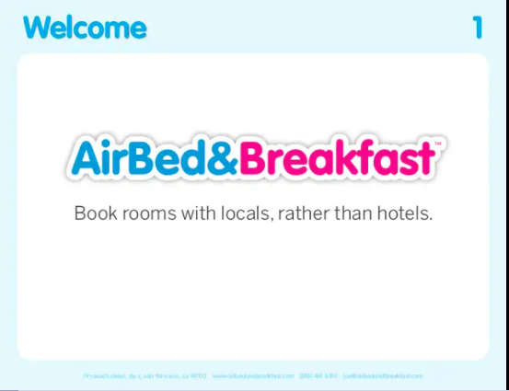

The Hook
Needs to be simple and catch your audience’s attention. Resist the urge to include more than the one-sentence description.
Example:
AirBnB (then AirBed&Breakfast): https://www.alexanderjarvis.com/airbnb-seed-pitch-deck/

Slide 3
The customer’s pain point
  Why are you building a company?
    A good reason for building a company is to solve a problem!
    Be specific…
      Too vague: “The world hates mosquitoes.”
      Right on: “HOA managers are willing to pay double for an environmentally friendly mosquito killer.”
  Who is experiencing the problem and who will be paying you to solve it?
    It is crucial for potential investors to understand:
      Who you are selling to and how does that person currently solve the problem?
      Is that person also the person that has the problem? Are they also the decision maker? Are they also the payer? How does it all work???
      What motivates these people? (you get the idea!)
  Please, please, please define YOUR market (can do on a separate slide).
    Example: if you sell high-end shoes, your market isn’t every foot in the world. It’s the group of people that can afford high-end shoes of your specific type and have demonstrated buying behavior that supports your assumptions around this being a scalable venture...
    At the bare minimum, include the customer profile, TAM, SAM, and SOM

Slide 4
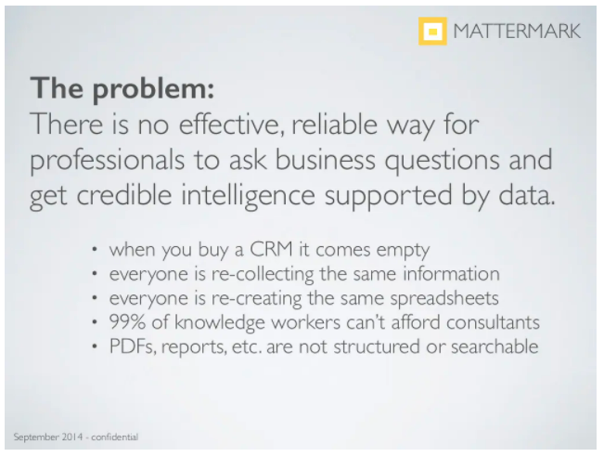
The customer’s pain point
Example:
Mattermark: https://www.slideshare.net/DanielleMorrill/mattermark-2nd-final-series-a-deck

Slide 5
Your Solution
  What have you created to solve the problem? Be ready to discuss:
    WHAT is the status (idea, prototype, MVP, commercial-ready, etc.)?
    HOW does it solve the problem like never before (anything proprietary)?
    WHY now (any recent trends that are relevant)?
  Provide use cases
    If your solution is already being used by customers, highlight the feedback you’ve received (and how you have perhaps pivoted, or double-downed on your original vision)
    If your solution is not ready for ‘prime time’ then, provide a typical scenario for how your solution would be utilized
  Be sure to convey your value proposition in making the customer’s pain go away

Slide 6
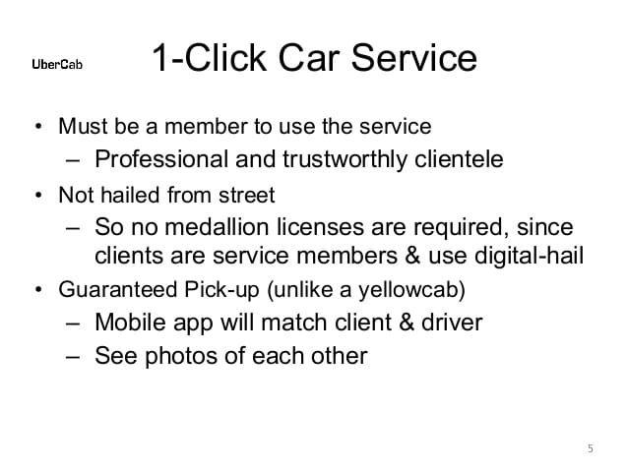
Your Solution
Example:
Uber (then Ubercab): https://www.slideshare.net/razinmustafiz/uber-pitch-deck-2008

Slide 7
The Competition
  What are the other solutions out there?
  What is your competitive advantage?
  How will you gain and defend a significant portion of the market?
  How do your solution’s features compare to competitors in terms of product, funding, backing, progress, positioning, etc.?
    Investors WILL diligence the details around your proposed solution, as well as solutions presented by your competition. If you provide inaccurate details, then investors will assume you don’t understand your own competition.
    Be sure to include/consider substitutes. For example, if you are working on a drug to cure an infection, please consider that products for preventing the infection all-together can be an existential threat to your solution.
    Focus on clear competitive advantages over competitors in the context of solving the customer’s problem better/more efficiently.

Slide 8
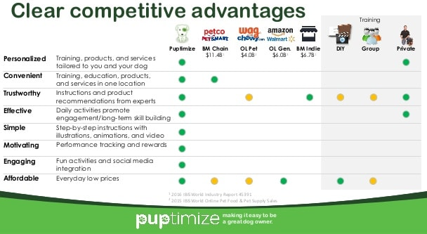
The Competition
Example:
Puptimize: https://www.slideshare.net/DJTodd1/2017-puptimize-pitch-deck-4-717

Slide 9
Business Model
  There is a difference in inventing a product vs. starting a business.
    Know which of these you’re doing and why.
  How do you make money?
    How is the transaction structured?
    What exactly are people paying you for, how often, and how much?
    Think: revenue model, pricing, average account size, sales/distribution, pipeline
  What are the unit economics?
    This demonstrates what your profitability will be at scale.
    If you’re early-stage, you might not know your exact unit economics, margins, LTV, CAC, or churn ratios (that’s okay!). Take a stab at them and explain your logic (be realistic!).
    What is the price and the quantity at which you can sell it?
    How much/many can you sell at a time?
Some companies aim to create their own market! These companies tend to become very valuable, but they typically require large amounts of capital.

Slide 10
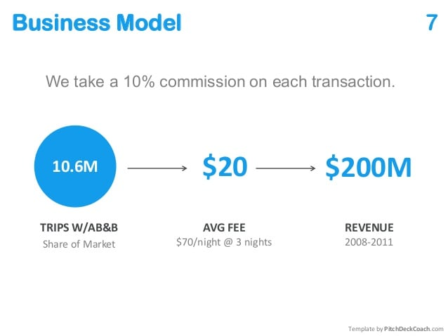
Business Model
Example:
AirBnB (then AirBed&Breakfast): https://www.alexanderjarvis.com/airbnb-seed-pitch-deck/

Slide 11
Customer Acquisition
  Both quantitative and qualitative input is necessary here.
    What have you learned through customer discovery?
    Who exactly are you targeting and how are you going to get their attention?
  If you already have traction, here is a good place to show it!
    However, many mature companies raising later-stage rounds create separate traction slides.
  Identify exactly who has the purchasing power.
    If you’re selling a medical product, explain how you’re going to convince the buyer for a major hospital system that your solution is more valuable than the alternatives.
    An estimate of the cost of your acquisition strategy per customer would be valuable here, but again, this is hard to estimate accurately. Make a logical assumption and be able to explain it.

Slide 12
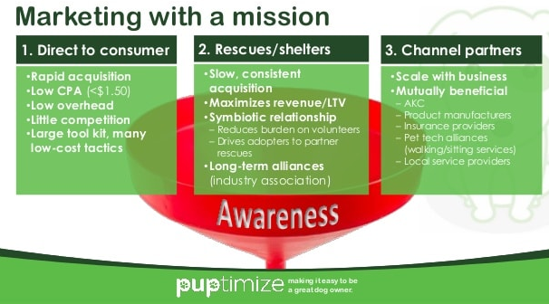
Customer Acquisition
Example:
Puptimize: https://www.slideshare.net/DJTodd1/2017-puptimize-pitch-deck-4-717

Slide 13
Operations Roadmap
Are you building a product or a company? Develop your roadmap.
  If it’s the latter, how are you going to build a company around this idea? How long will that take you? How much of it will you accomplish within the current capital raise? How many people will you need?
  Be prepared to explain WHY this is the optimal road map.
    Don’t pitch a software solution and simultaneously tell investors that you didn’t realize you might need to hire a programmer at some point.
    Explain how you determined the future needs of the business, how you prioritized those needs, how you plan to incentivize people to join your team.
    What is the capital pathway from here? Tip, businesses usually need more money and take more time than expected, but don’t be too aggressive with your assumptions here.

Slide 14
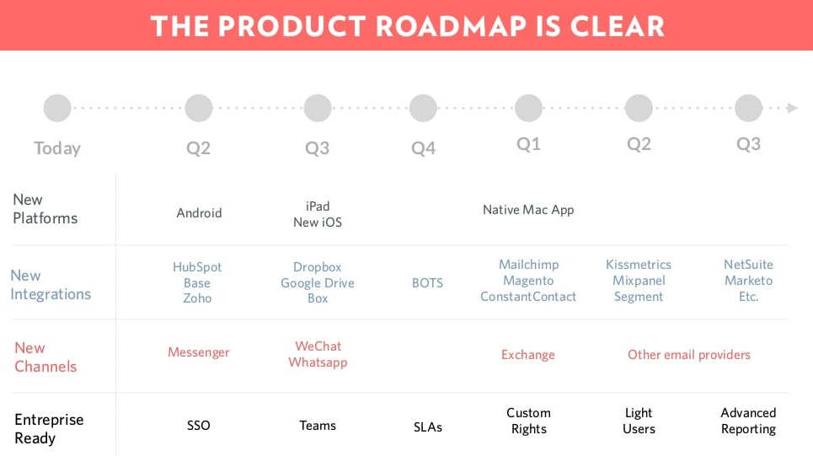
Operations Roadmap
Example:
Front: https://www.slideshare.net/MathildeCollin/front-series-a-deck-64596550

Slide 15
Team
  Descriptions of your team should demonstrate why these individuals have been selected to help you deliver on the value creation strategy you’ve outlined.
    Do include founders, management, board of directors, board of advisors
    Do NOT include a bunch of people that have fancy titles that you’ve had only limited interactions with or don’t have actual buy-in to your company.
  Investors’ willingness to pay staff changes as a company matures. In the early days, they will want to pay for the minimum number of people needed to adequately test the proposed business thesis.
  Articulate how the founder team works together – who makes the final decisions?
  Pro tip: If you’re husband/wife, mother/daughter, brother/sister team, or related in any way, be able to explain what happens to your Thanksgiving celebration if this business fails!

Slide 16
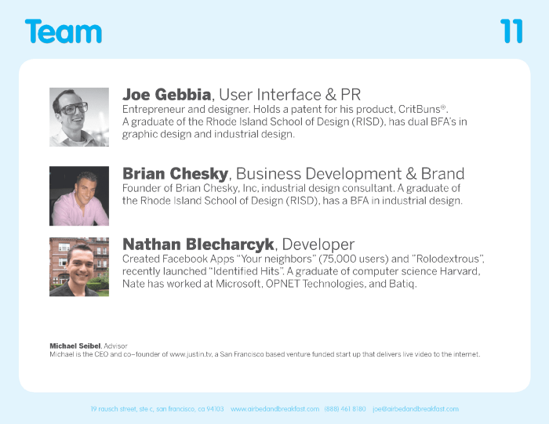
Team
Example:
Airbnb: https://medium.com/pitchdecks/pitch-deck-teardown-airbnb-df213beab2ce

Slide 17
Unit Economics & KPIs
  This may call for its own slide if you choose not to include this information in the Business Model section, have a later-stage company and can provide data driven statistics, or simply choose to do so.
  Specifics are needed, even if they aren’t set in stone. Consider a combination of the following:
    Customer Lifetime Value (LTV)
    Customer Acquisition Cost (CAC)
    Customer Churn
    Purchase Frequency
    Annual recurring revenue (ARR)
    Per Unit Revenue
    Unit Production Cost
  Milestones
    Current round milestones & ultimate milestones
    If these don’t match earlier statements that outline your total addressable market, capital and time needs, and other sections, investors will notice.

Slide 18
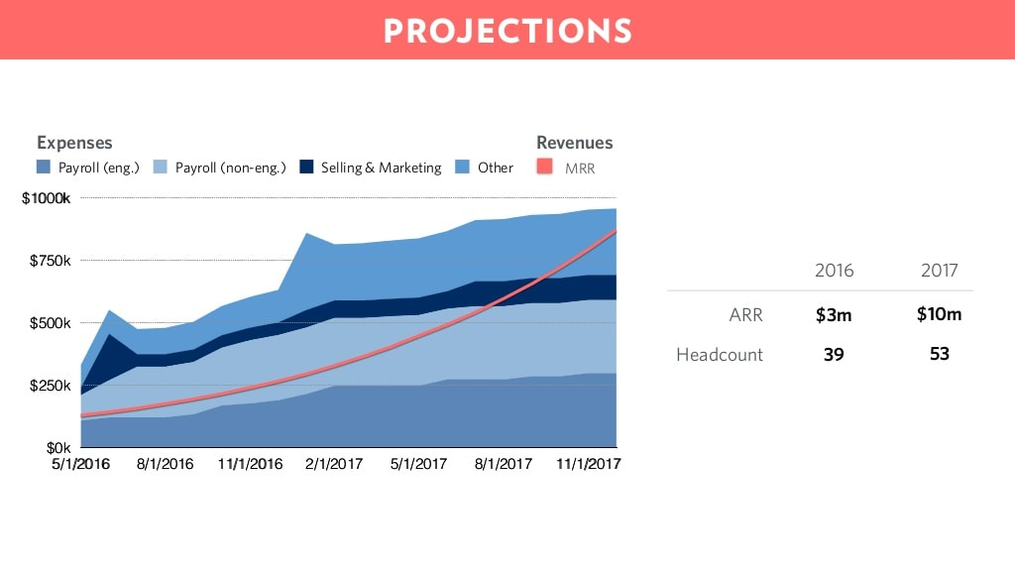
Unit Economics & KPIs
Example:
Front: https://www.slideshare.net/MathildeCollin/front-series-a-deck-64596550

Slide 19
Call To Action
  Why are we here? What are you asking for?
    What round is it (Pre-seed, Seed, Series A, etc.)?
    How much money do you need?
    Do you already have commitments? If so, how much?
    Are you looking for a lead investor or co-investors? If you have a lead, what are the terms of the round?
  WHY DO YOU NEED THIS MONEY?
    Clearly articulating your intended use of the dollars raised is critical. Providing an excel document with a Use of Funds breakdown within the pitch is a great way to do this.
  Don’t put this into writing anywhere, but a smart founder will woo their investor a bit here. Tell them why they are the best investor for your product and why you want them to be on your cap table more than anyone else. Everyone wants to feel valued, and you’re selling something here!

Slide 20
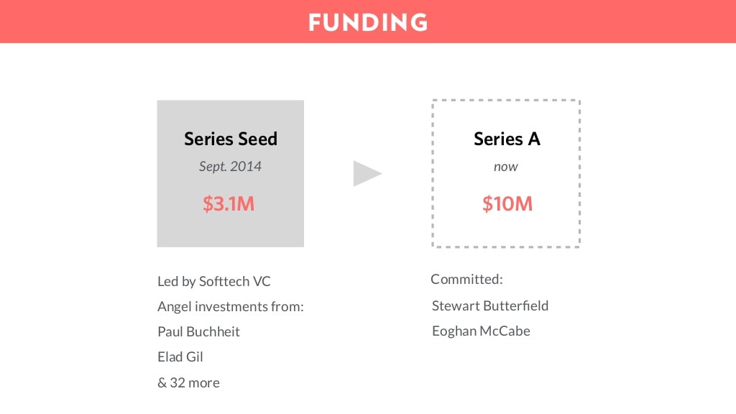
Call To Action
Example:
Front: https://www.slideshare.net/MathildeCollin/front-series-a-deck-64596550

Slide 21
Questions?
Include this slide as a wrap up
to the presentation

Slide 22
Appendix
  This is a great place for other relevant information:
    Including relevant additional data in the appendix keeps the pitch short but allows for questions to be answered live with backup data or information to be shared when the deck is sent to the investor.
    This is a great place for highly technical companies to include product information. If you’ve connected with an investor who is well versed in your industry, you can dive into the weeds here.

